Slide 1
PROFITABILITY & PRICING ANALYSIS
TastyBites: Fixing the
Profit Behind the Orders
A 2-year review of orders, discounts and margins to sharpen pricing and
promotion strategy without losing customers.

Slide 2
EXECUTIVE SUMMARY
Discounts Are Quietly Eating the Margin
$12.1M
31.9%
$531K
$173.50
2-Year Revenue
Overall Profit Margin
Profit Lost to Discounts
Average Order Value
69,655 orders across 37 items
$3.85M total profit
12.1% of potential profit
fairly consistent across all 6 cities
Margin erodes almost linearly with discount depth: orders with no discount run a 37% margin; orders discounted 20-25% run close to break-even. A handful of high-volume items (Cheese Burger, Family Feast Combo, Paneer Tikka, Chocolate Brownie) sell extremely well but contribute very little profit — they're funding volume, not the bottom line.
METHOD
2 years (Aug 2024–Jul 2026) of order-line data across 37 products / 8 categories / 6 cities. Category labels standardized; missing discount values imputed at the product level; discounts capped at the 25% policy ceiling as a data-quality check.
2

Slide 3
BACKGROUND
Why This Analysis, Why Now
Some products drive huge order volumes but barely move the profit needle, while others quietly generate strong margins at lower volume. Management wants pricing and promotions tuned to grow profit — not just orders — without scaring customers away.
KPIs TRACKED
Revenue per Product
1
Separate signal from noise
Profit Margin per Product
Identify which products/categories actually drive profit vs. just revenue
Units Sold
2
Quantify discount cost
Discount Impact (profit loss)
Measure how discount depth translates into margin loss
Contribution to Total Profit
3
Recommend action
Target price and promo adjustments that protect volume
Average Order Value (AOV)
CONSTRAINTS: discounts capped at 25%; customers price-sensitive above 10% increases; profit = revenue − cost (delivery excluded).
3

Slide 4
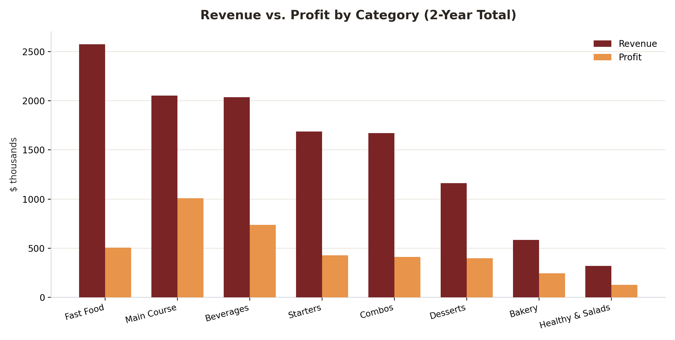
CATEGORY PERFORMANCE
Revenue Leaders Aren't Always Profit Leaders
READING THE GAP
•
Fast Food leads on revenue ($2.57M) but ranks near the bottom on margin (19.6%) — it's the biggest revenue-profit gap in the portfolio.
•
Main Course is smaller in revenue but delivers the highest profit share (26.1%) thanks to a 49% margin.
•
Beverages combine solid revenue and a healthy 36% margin — a genuinely strong category, not just a volume driver.
4

Slide 5
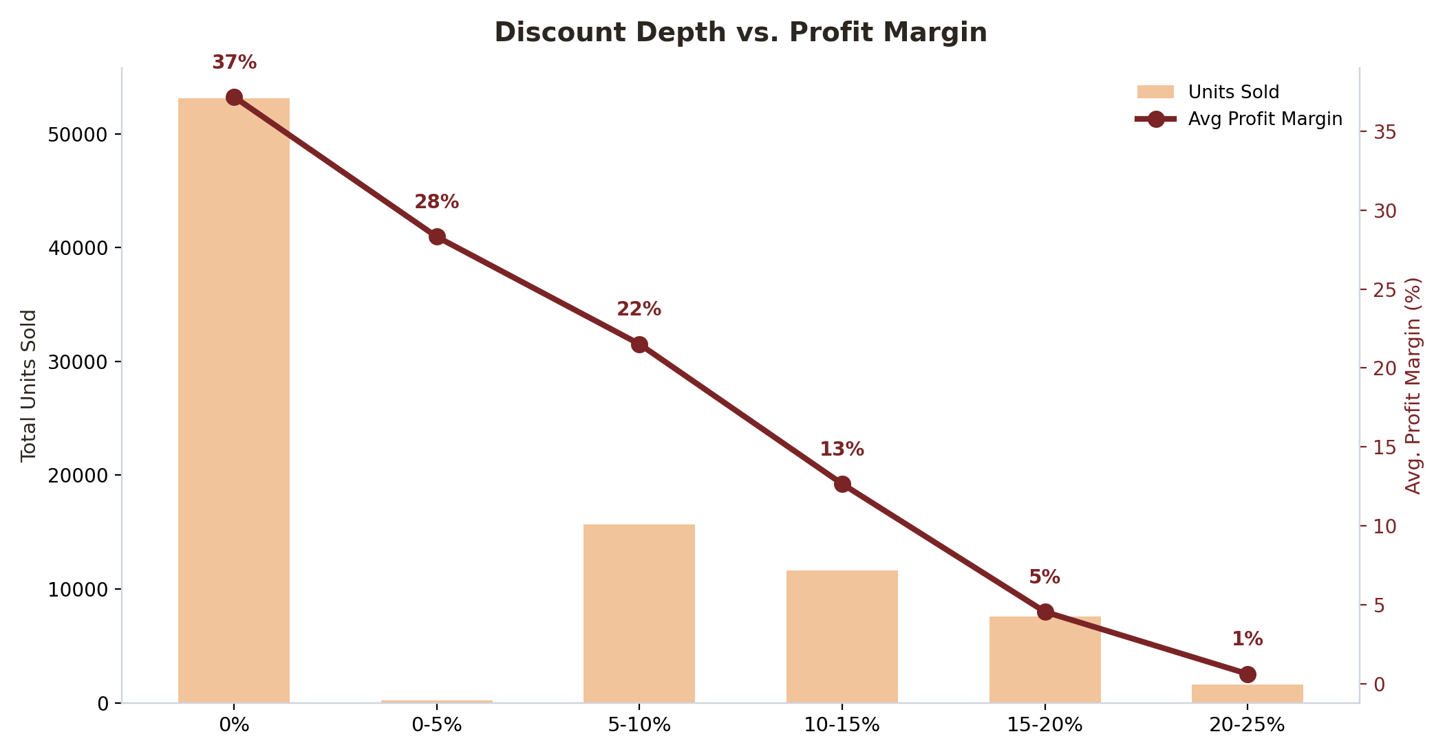
DISCOUNT IMPACT
Every 5 Points of Discount Costs ~6-8 Points of Margin
KEY TAKEAWAY
Undiscounted orders run a 37% margin. By the 20–25% discount band — the policy ceiling — average margin has collapsed to just 1%, essentially break-even.
Deep discounts (15%+) drive only a modest volume lift versus the 5-10% band, but destroy nearly all the margin — the trade-off stops paying off well before the policy cap.
Total profit forfeited to discounting over 2 years: $531K (12.1% of potential profit).
5

Slide 6
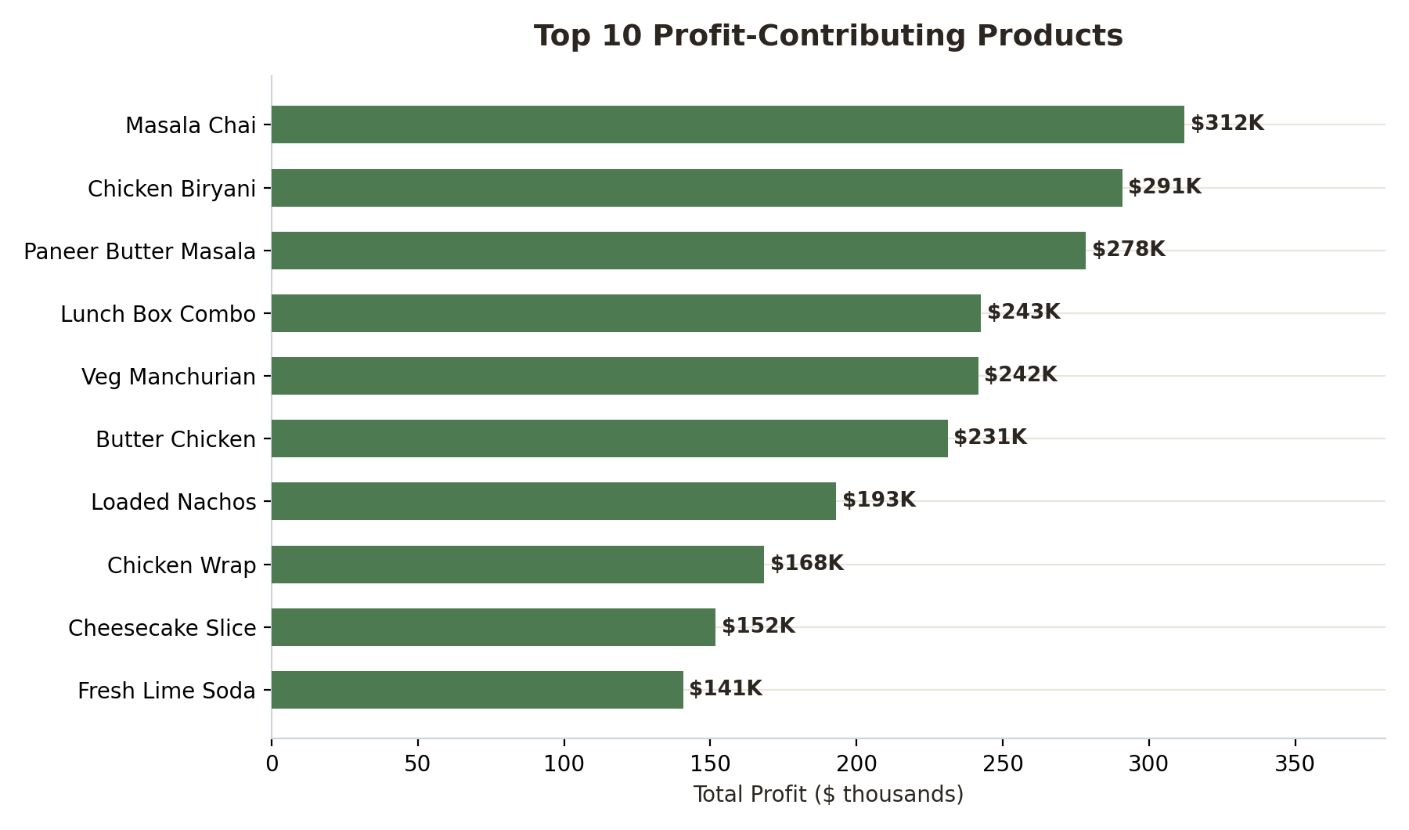
HIGH-PROFIT PRODUCTS
A Small Set of Items Drives Outsized Profit
WHAT STANDS OUT
•
Masala Chai and Chicken Biryani alone contribute over 15% of total company profit, at 52%+ margins.
•
Chicken Wrap sells the most among the top-10 profit list (5,235 units) but its margin (20%) is far thinner — worth protecting from further discounting.
•
Main Course and Beverages products dominate this list — reinforcing they're the categories to protect and grow.
6

Slide 7
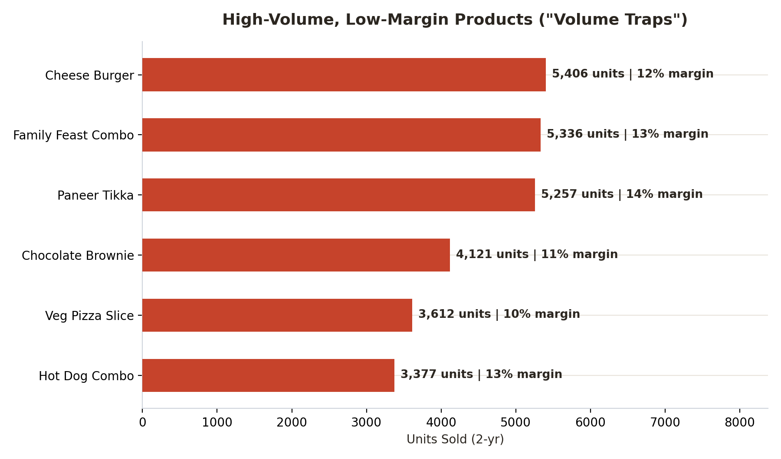
SELLS A LOT, PROFITS LITTLE
6 Products Are Classic "Volume Traps"
WHAT'S GOING ON
•
Cheese Burger and Family Feast Combo are the top-2 sellers in the entire catalog by units — but both run margins near 12-13%.
•
These items sit in the top third for volume and bottom third for margin — moderate discounting (6-10% avg) plus already-thin base pricing.
•
They shouldn't be cut — they likely drive traffic and cart size — but they're strong candidates for a modest price increase or reduced discount depth rather than further promotion.
7

Slide 8
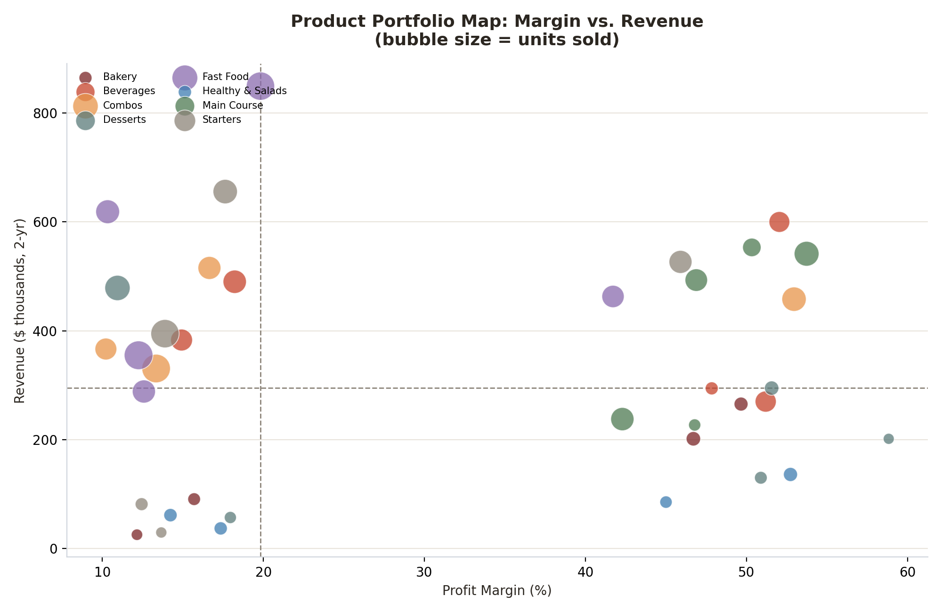
PRODUCT PORTFOLIO VIEW
Where Each Product Sits: Margin vs. Revenue
QUADRANT GUIDE
Top-right
Stars — high revenue, strong margin. Protect and promote.
Top-left
Volume traps — high revenue, weak margin. Trim discounts / nudge price.
Bottom-right
Niche premium — lower revenue, high margin. Good bundling candidates.
Bottom-left
Underperformers — low revenue, low margin. Reassess or retire.
8

Slide 9
RECOMMENDATIONS
Quick Wins and Long-Term Strategy
QUICK WINS (0–90 DAYS)
LONG-TERM STRATEGY
Cap discounts on Cheese Burger, Family Feast Combo, Paneer Tikka & Chocolate Brownie at 5% — margin gains outweigh the modest volume risk (customers are only price-sensitive above 10%).
Introduce category-level discount governance: Fast Food & Combos need tighter limits than Main Course & Bakery, which already protect margin well.
Promote high-margin winners (Masala Chai, Chicken Biryani, Paneer Butter Masala) harder in-app instead of discounting Fast Food items further.
Test a 5-8% price increase on steady, low-discount sellers (Chicken Biryani, Lunch Box Combo) — both sell consistently with minimal promo reliance, signaling room to move price.
Bundle niche-premium, low-volume items with top sellers to lift their exposure without discounting them directly.
Shift promotional spend from blanket discounts toward combo/bundle pricing that raises basket size (AOV) instead of cutting per-item margin.
Set a discount ceiling of 10-12% as a soft internal guideline — the data shows returns turn negative well before the 25% policy cap.
Build a quarterly product review using the margin-vs-revenue map to systematically reposition or retire bottom-left underperformers.
9

Slide 10
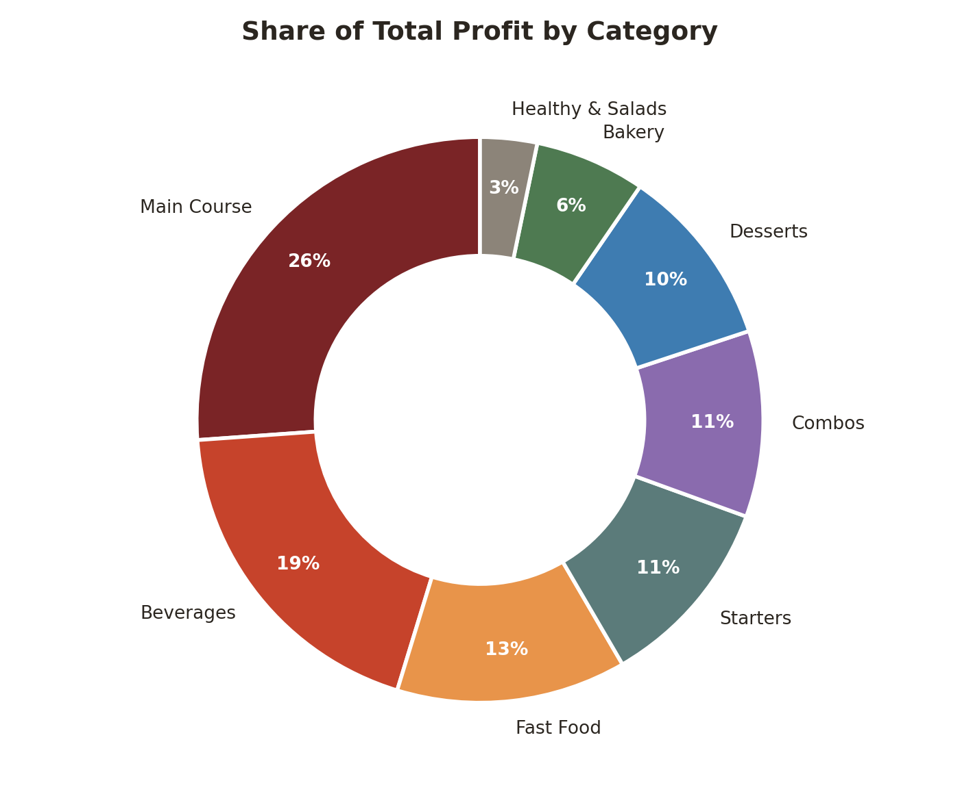
WHERE PROFIT SHOWS UP
Category Profit Share & Next Steps
NEXT STEPS
1. Pilot
Cap discounts on the 6 volume-trap SKUs in 2 cities for 60 days; track units sold and margin weekly.
2. Reprice
Raise price 5-8% on the 3-4 lowest-discount, highest-volume steady sellers identified as low-elasticity risk.
3. Rebalance promos
Redirect the freed-up discount budget into bundles built around high-margin Main Course & Beverages items.
4. Review
Re-run this analysis quarterly to track whether margin recovers without an order-volume drop.
10

